Slide 1
Food Demand Forecasting
Sumanth Kumar Goud Golla

Slide 2
Agenda
Introduction
Literature
Data Transformations performed
Data description
Data Exploration
Predictive Modelling
Findings
Recommendations for Business

Slide 3
Questions to be explored
How does food demand vary by food category, cuisine type, city and center?
How effective are promotional email campaigns and homepage featured items in driving food demand?
How can restaurants optimize their revenue?
How accurately can we predict food demand using the available data, and what factors are most important for making accurate predictions?

Slide 4
Business relevance of questions
Food wastage is a big issue that should be addressed by every restaurant. On average, 22 to 33 billion lbs of food is wasted every year by the American restaurant industry.
This can be reduced if the restaurants can get an accurate estimate of the orders through which they will be well prepared to handle the inventory more efficiently. This can be achieved by doing the following analysis:
Demand Forecasting
Menu Optimization
Price analysis

Slide 5
Literature
Aspect | Previous Analysis | Our Project
Data Exploration | Light Data Exploration | Exploratory Data Analysis (EDA)
Data Pre-processing | Data Pre-processing, Data Normalization | Data Pre-processing, Data Normalization
Feature Engineering/Selection | Feature Selection | Feature Engineering and Selection
Modeling | Linear Regression, Decision Tree Regressor, Random Forest Regressor | Linear Regression (with cross-validation), Decision Tree Model, Random Forest Regression Model, Gradient Boosting Model
Evaluation Metrics | R2 score and, RMSE | R2 score, RMSE and MAPE
Questions Addressed | How to predict demand for the upcoming 10 weeks? | 1) How does food demand vary by food category, cuisine type, city, and center? 2) How effective are promotional email campaigns and homepage featured items in driving food demand? 3) How can restaurants optimize their revenue? 4) How accurately can we predict food demand using the available data, and what factors are most important for making accurate predictions?

Slide 6





Methodology
Dataset
Data Preprocessing
EDA and Feature Engineering
Business findings and recommendations
Predictive Modelling

Slide 7

Dataset
Dataset source: Kaggle
No. of Rows - 456,549
No. of variables - 15
Dataset
City_code
Meal_Id
Center_Id
Center_info
Id
Meal_Id
Week
Center_Id
Checkout_price
Base_price
Emailer_for_promotion
Homepage_featured
Meal_info
Num_orders
Category
Cuisine
Region_code
Centre_type
Op_area
Train

Slide 8
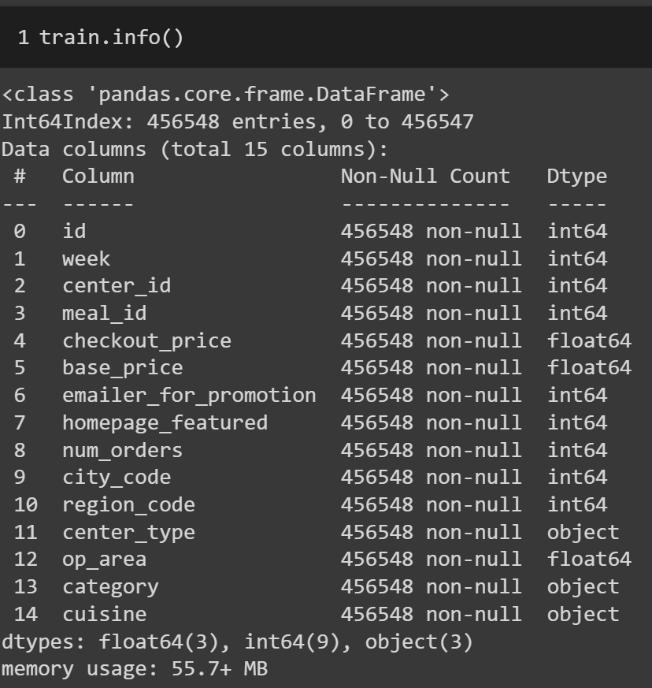
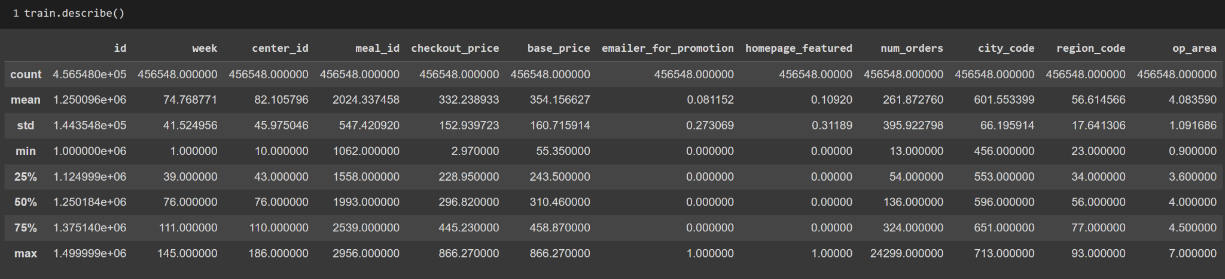
Data Description:

Slide 9
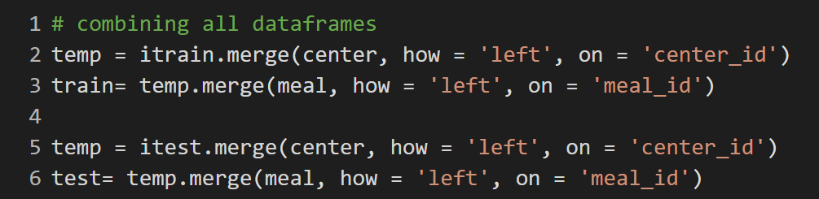
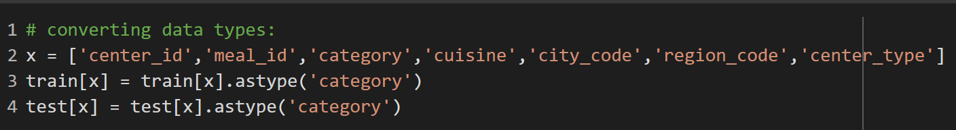
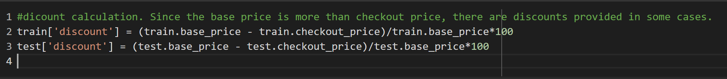
Data Transformations:
Train, Meal_info and Center_info were joined into a single dataframe using following code:
The following variables were changed from Int64 to category
New variable introduced: Discount percentage

Slide 10
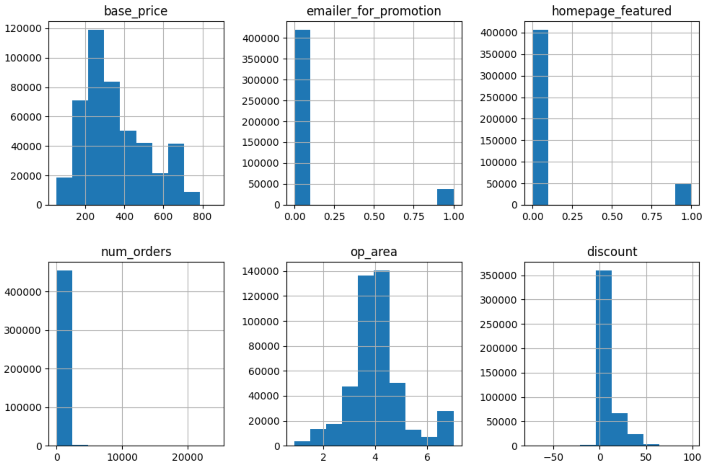
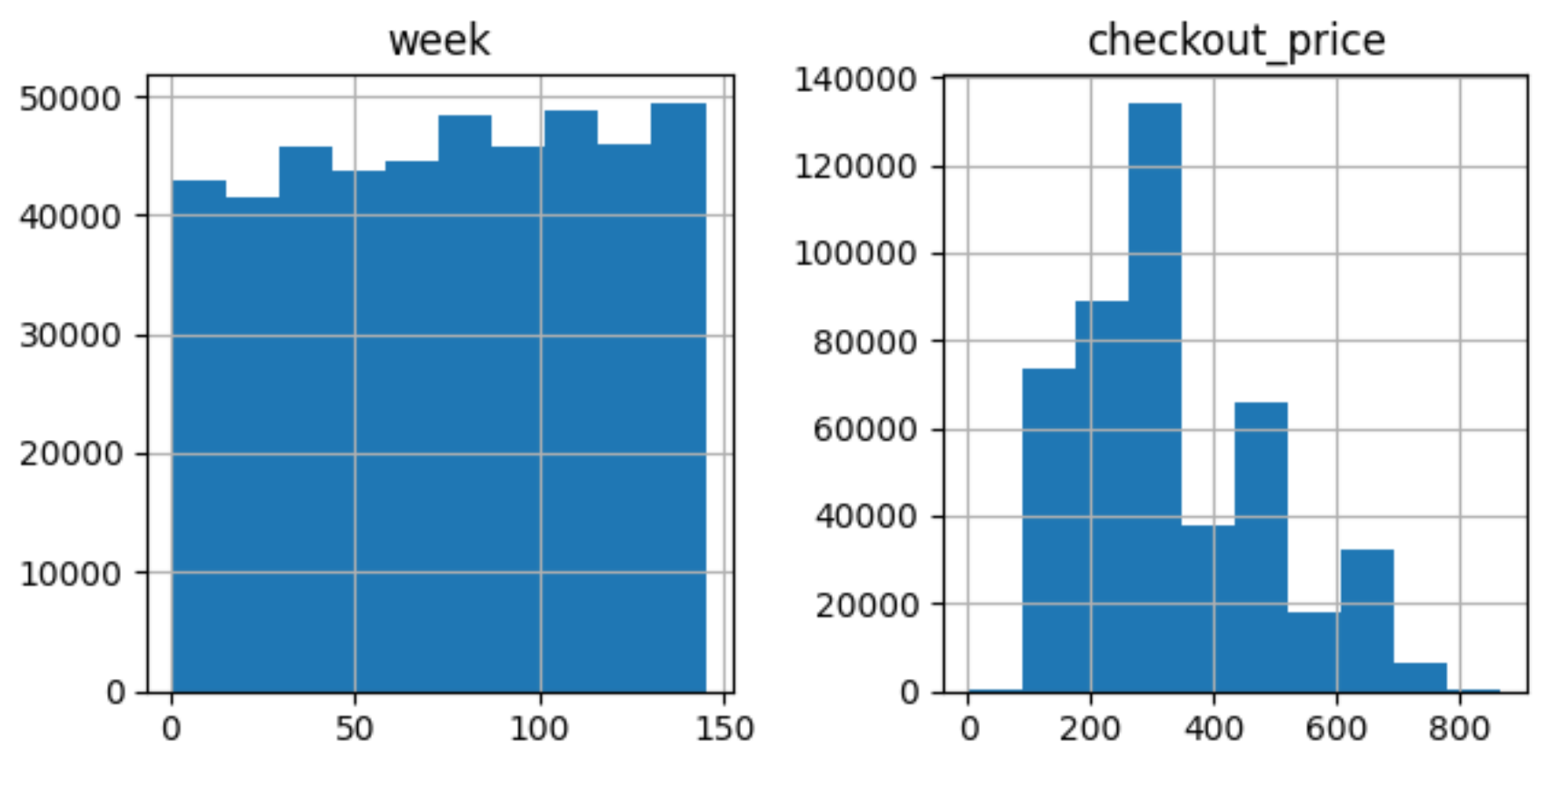
Exploratory Data Analysis:

Slide 11
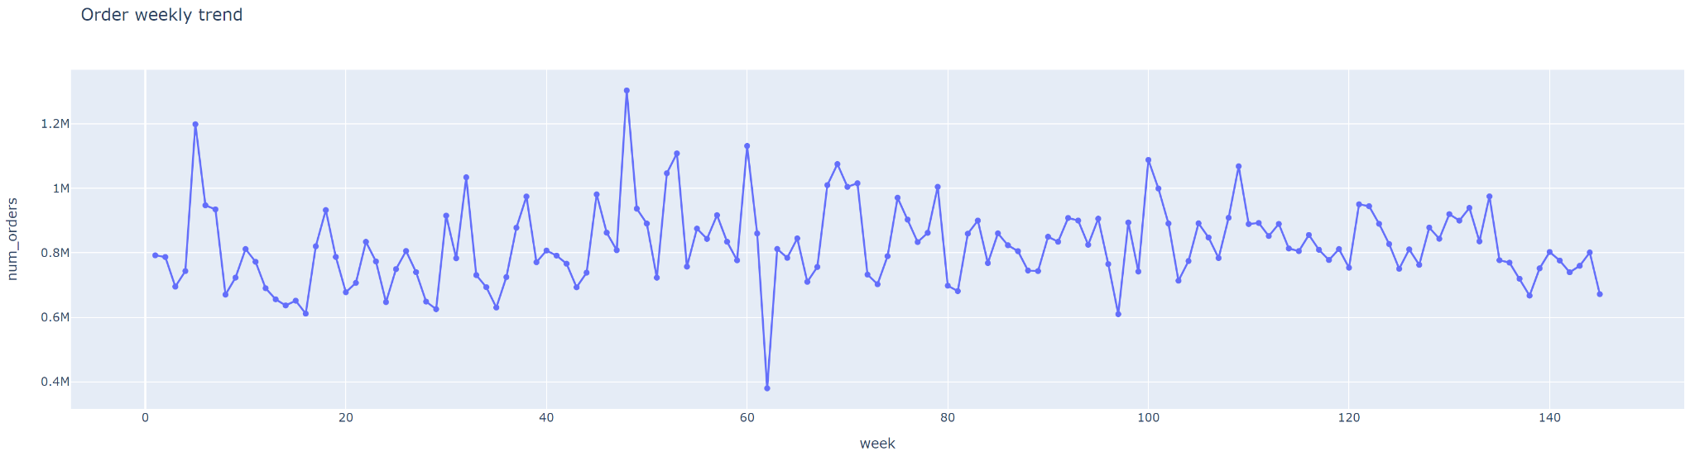
Exploratory Data Analysis:
No trend and seasonality observed.

Slide 12
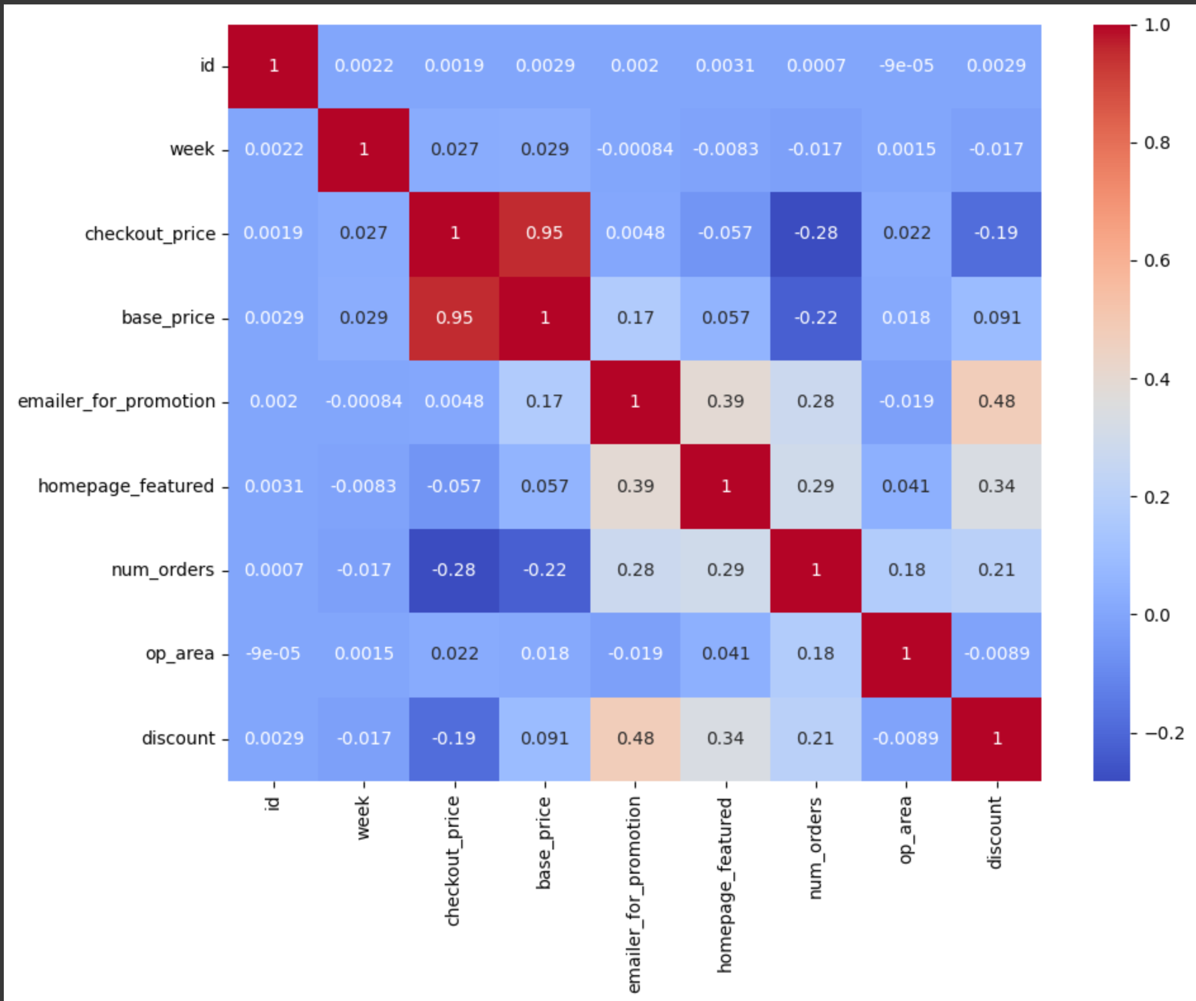
Exploratory Data Analysis
1. Checkout_price and base_price have positive correlation. They are directly proportional to each other and one of them can be removed from the analysis. Base_price will be removed as it has less correlation w.r.t target variable
2. Id removed from analysis as it is only a series of numbers generated to differentiate distinct rows
3. The variables that can act as best predictors are :
homepage_featured
emailer_for_promotion
checkout_price

Slide 13
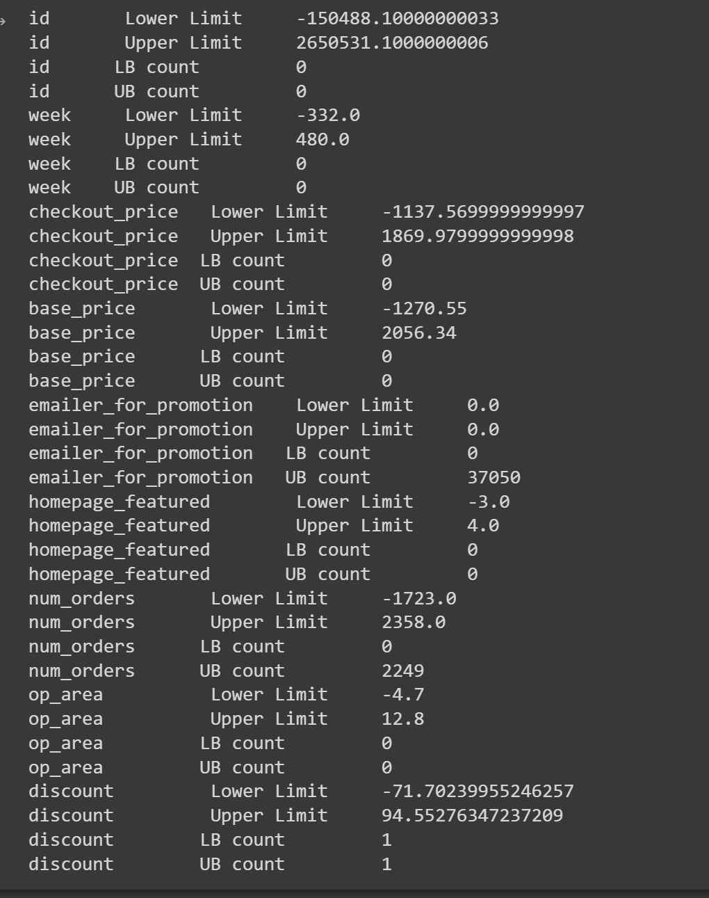
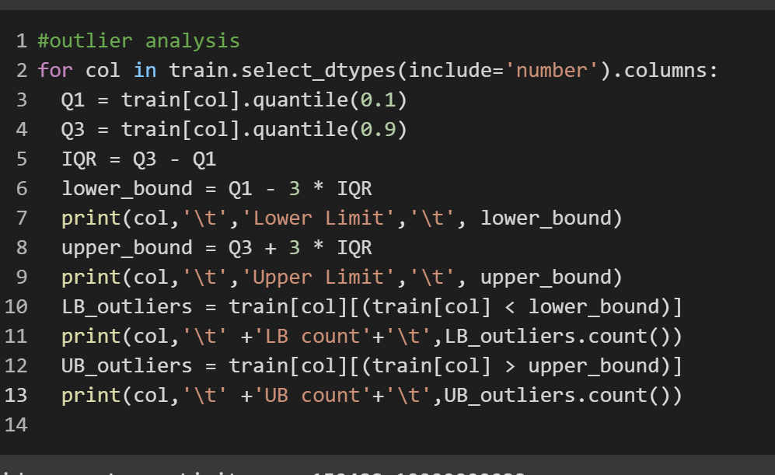
Exploratory Data Analysis
Outlier Analysis:

Slide 14
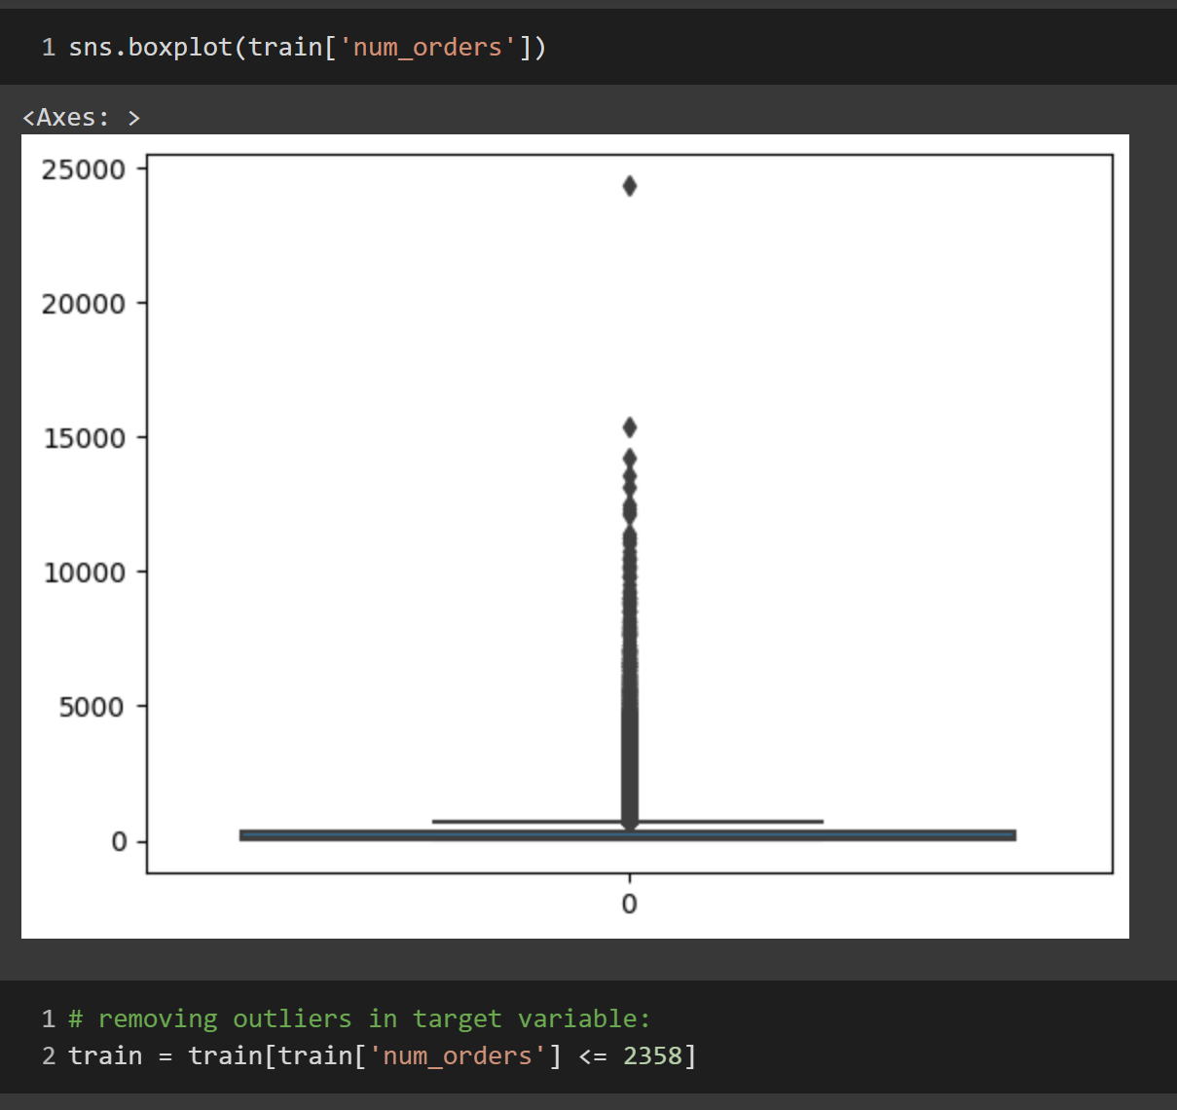
Exploratory Data Analysis
Outlier Analysis:
Outliers in target variable removed .

Slide 15
Predictive Modelling
Models:
Linear Regression
Decision Tree
Random Forest
Gradient Boosting
Input Variables:
Week
Center_Id
Meal_Id
Checkout_price
Emailer_for_promotion
Homepage_featured
City_code
Region_code
Center_code
Op_Area
Category
Discount
Cuisine

Slide 16
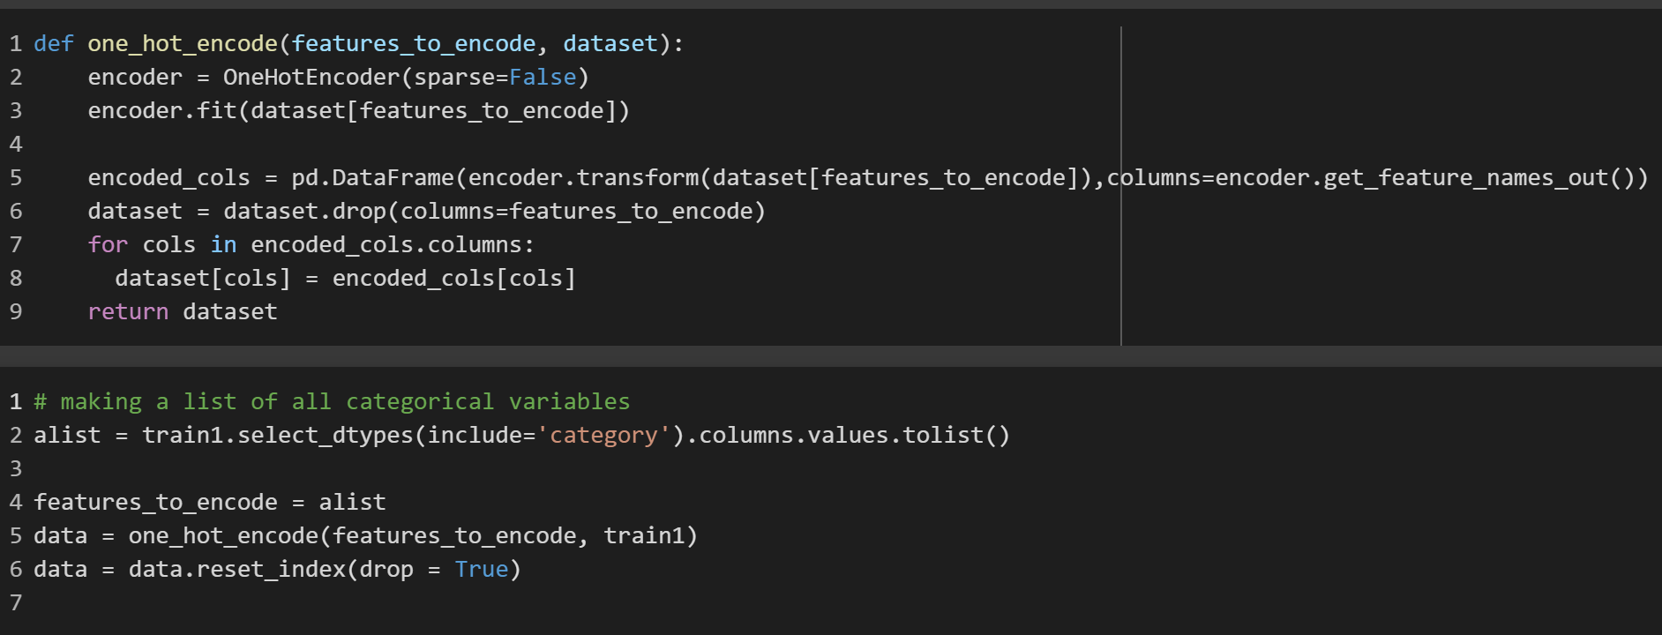
Predictive Modelling
Data Transformation:
All categorical variables were transformed into dummy variables using OneHotEncoder function. A function was defined to take the categorical variables and convert them to dummy variables, add them to the remaining dataset and provide the joined dataset as output.

Slide 17
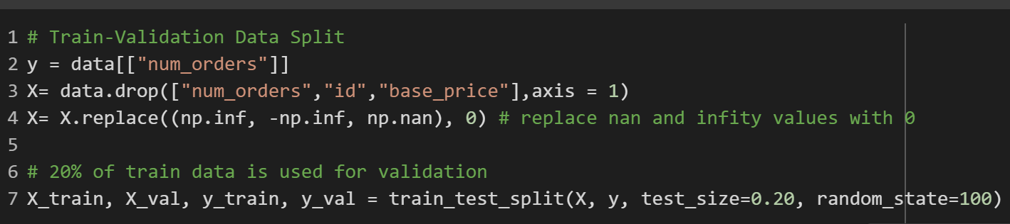
Predictive Modelling
Training and Validation split:
The entire training data set was divided into 80 Percent training data and 20 percent validation data.

Slide 18
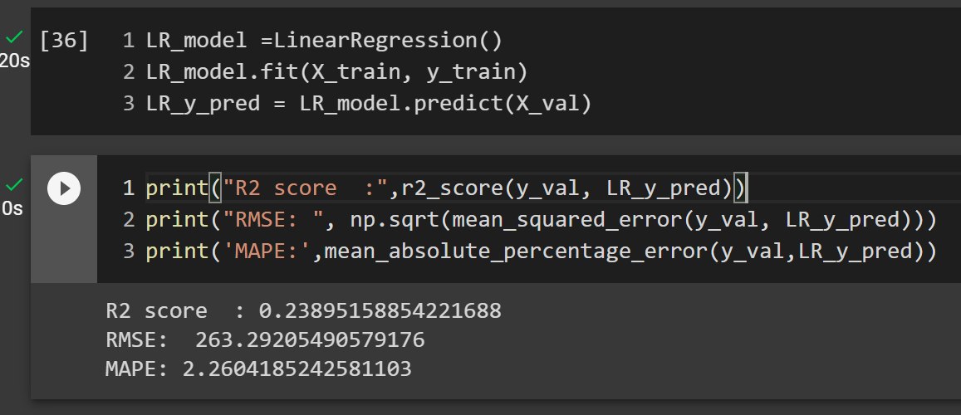
Predictive Modelling
Linear Regression Model:

Slide 19
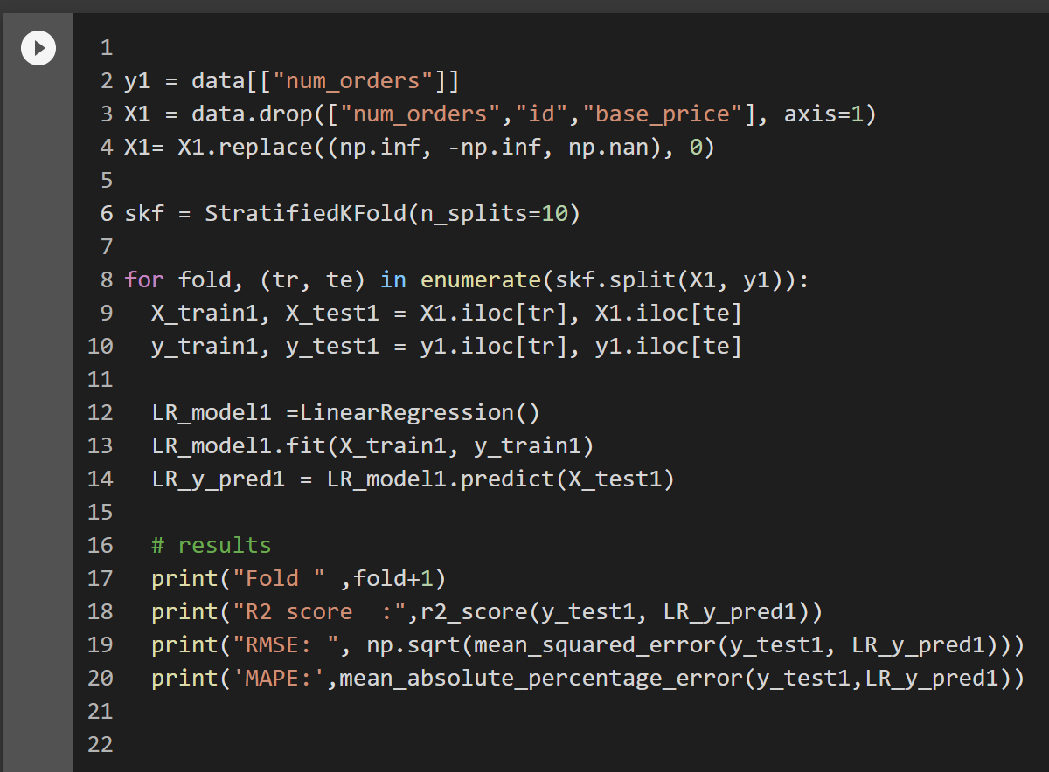
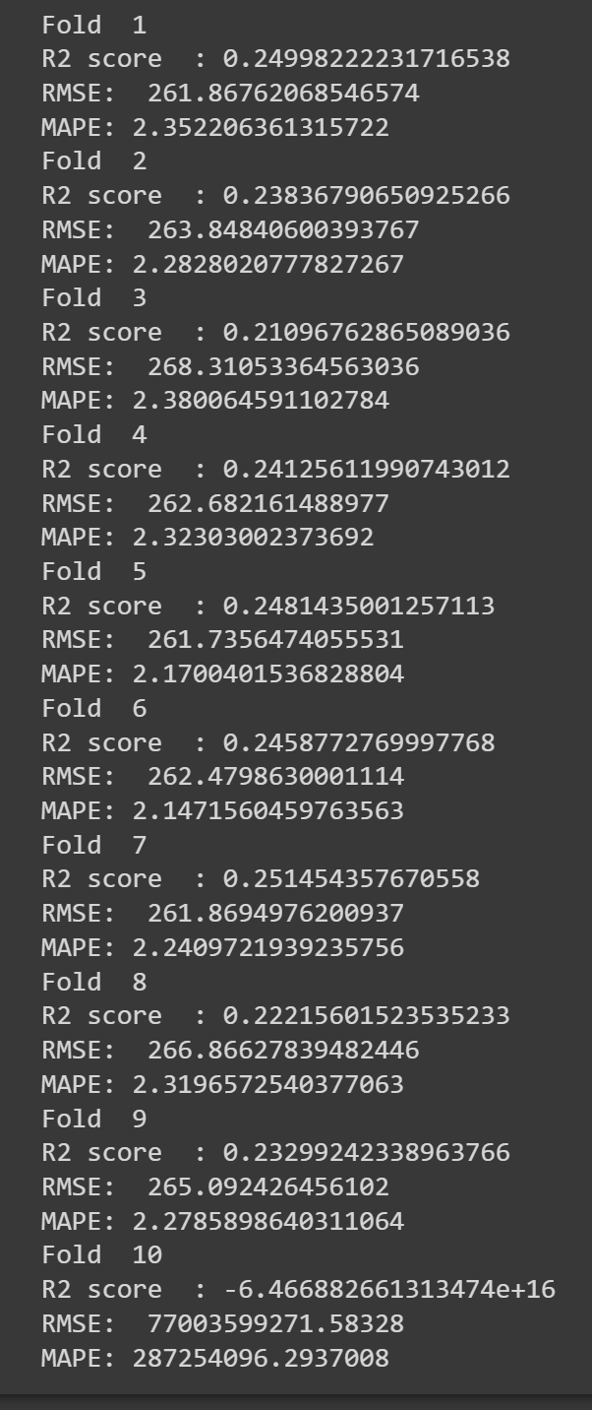
Predictive Modelling
Cross Validation in Linear Regression Model:

Slide 20
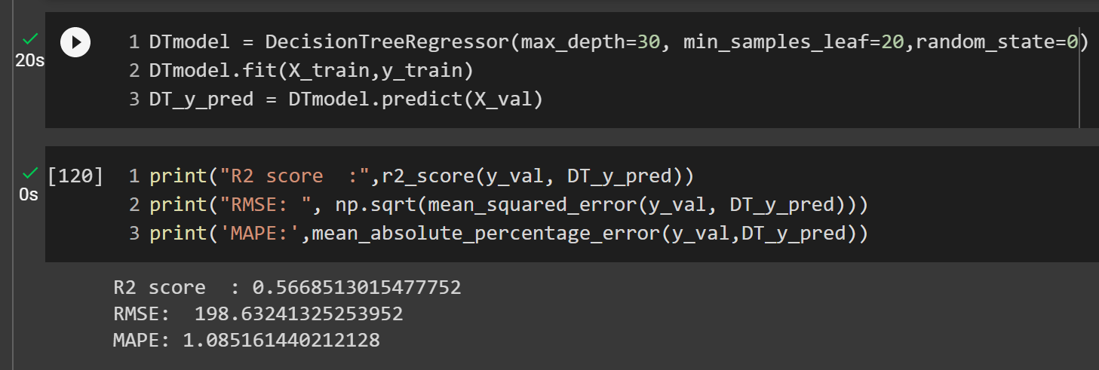
Predictive Modelling
Decision Tree Model:

Slide 21
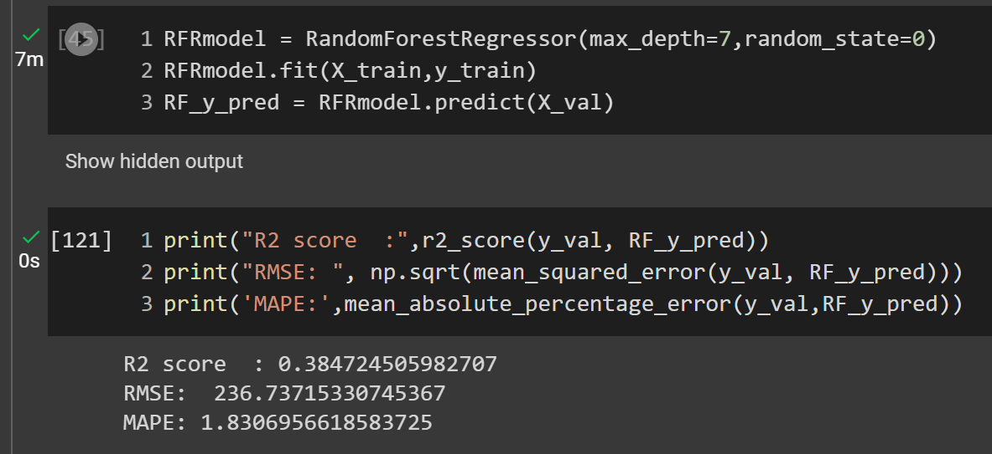
Predictive Modelling
Random Forest Regression Model:

Slide 22
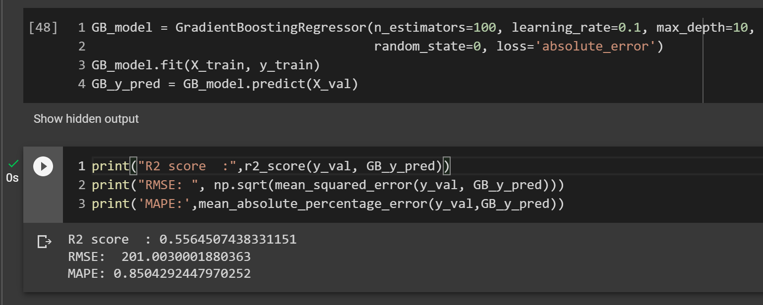
Predictive Modelling
Gradient Boosting Model:

Slide 23
Model Evaluation
Parameter | Linear Regression | Decision Tree | Random Forest | Gradient Boosting
R2_Score | 0.24 | 0.57 | 0.38 | 0.55
RMSE | 263.29 | 198.63 | 236.74 | 201.00
MAPE | 2.26 | 1.08 | 1.83 | 0.85
Model Selected: Decision Tree
Factors: Higher R2 score and lower RMSE.

Slide 24
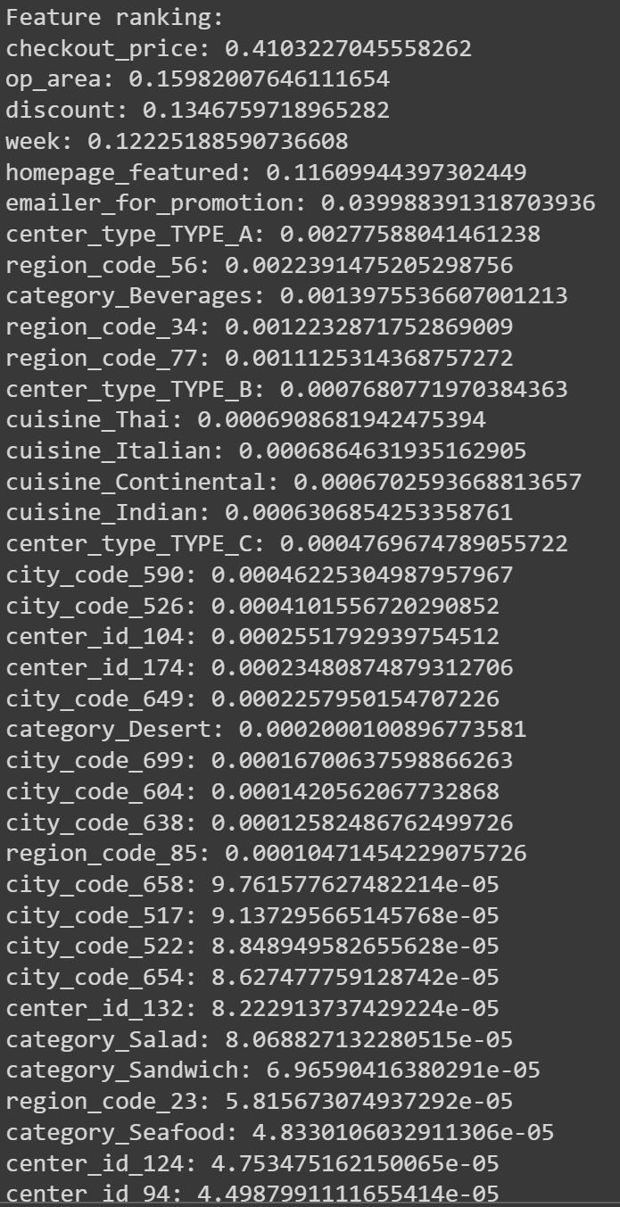
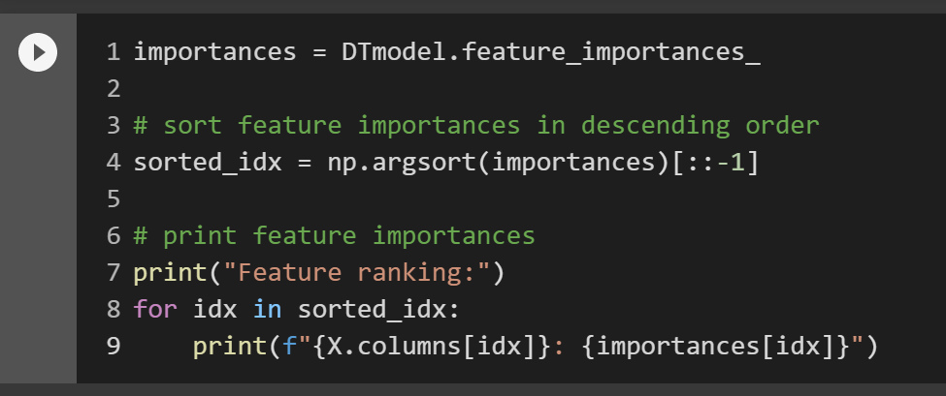
Model Evaluation
Important Variables/Features:

Slide 25
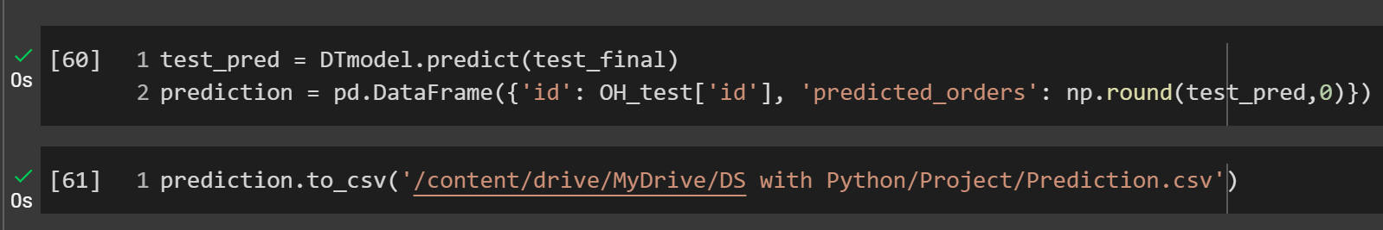
Predictive Modelling
Prediction of orders in Test dataset:

Slide 26
Findings:
Beverages are the most ordered item across all centres.
Type A has the highest number of orders.
Most ordered food category per centre:
Type- A: Rice bowl in Indian Cuisine
Type - B: Rice bowl in Indian Cuisine
Type - C: Sandwich in Italian Cuisine
Items featured in homepage received more orders compared to those that were not featured in homepage
Email promotions have doubled the average orders.

Slide 27

Recommendations for Business:
Menu and Price Optimization
Promote low cost items and items with less orders more on homepage and emails to increase revenue.
Focus on regions with lower operating areas to boost the orders by offering discounts and coupons.
Only offer discounts in range 0% to 50%. Beyond that
will not yield fruitful results.

Slide 28
Thanks!

